Slide 1
Instructions for authors on using the website psystudy.ru

Slide 2
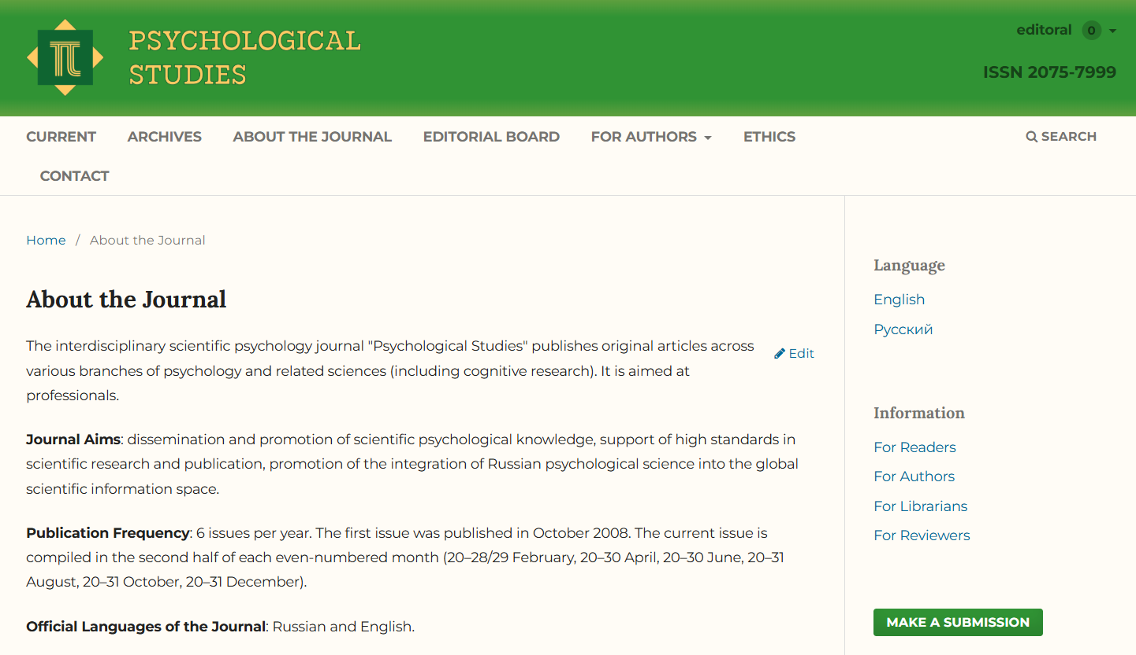
Register on the psystudy.ru as an author and click the «Make a submission» button

Slide 3
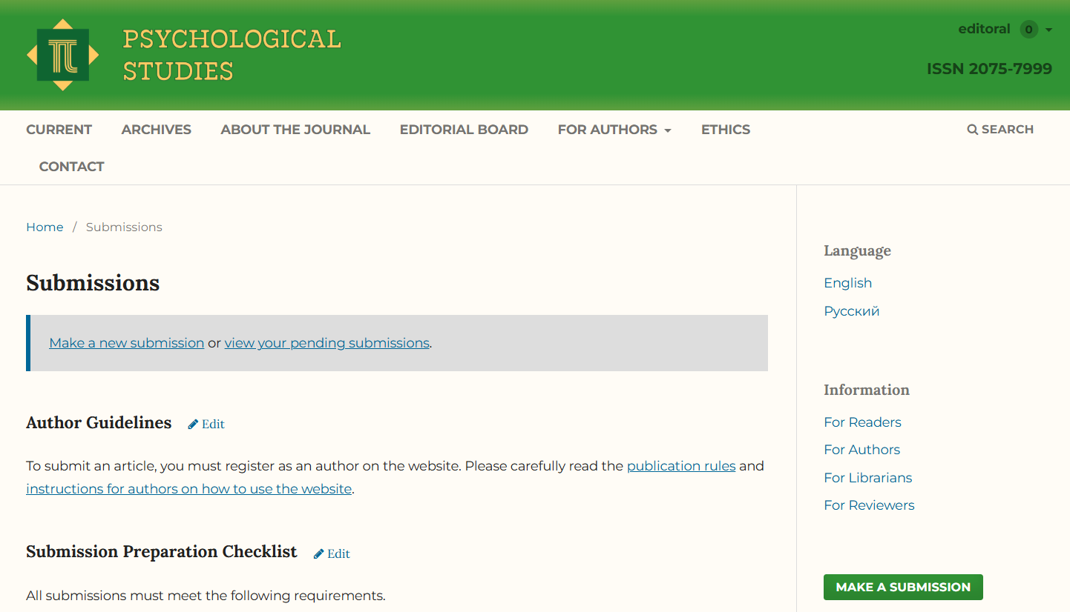
Click the «Make a new submission»

Slide 4
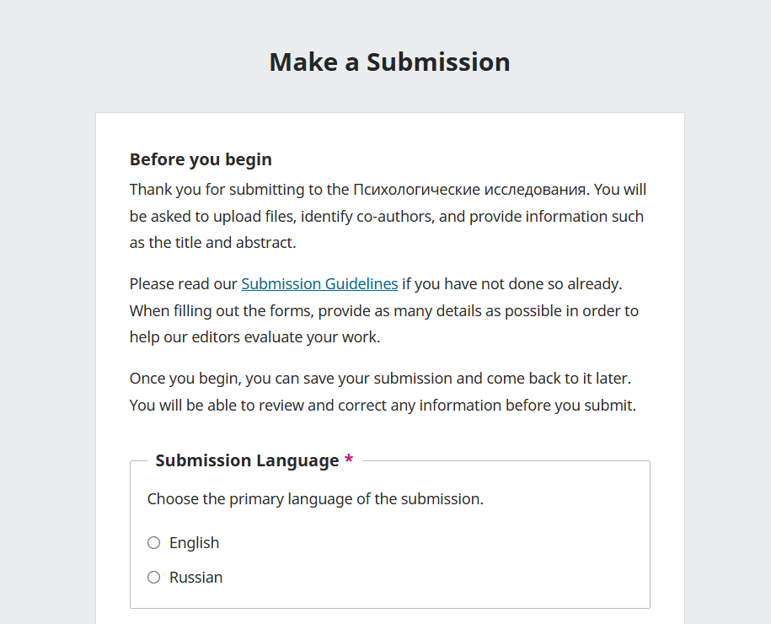
Fill in the required fields and click «Continue» at the bottom of the page

Slide 5
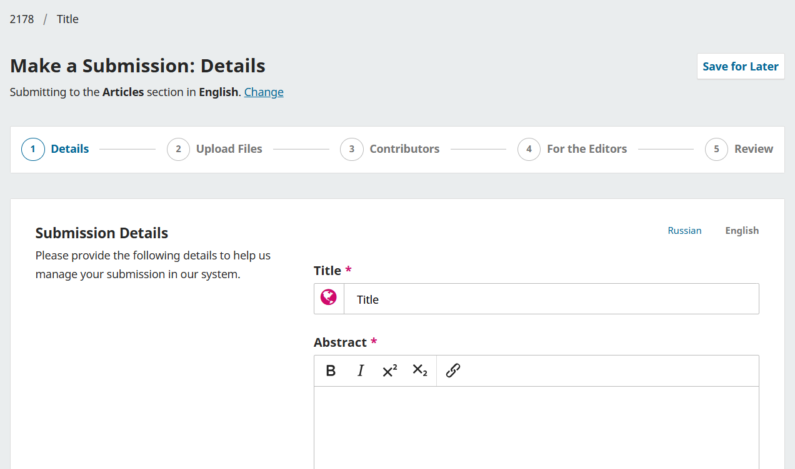
Enter the title, abstract, and references. To switch to Russian, use the toggle. Then click «Continue»

Slide 6
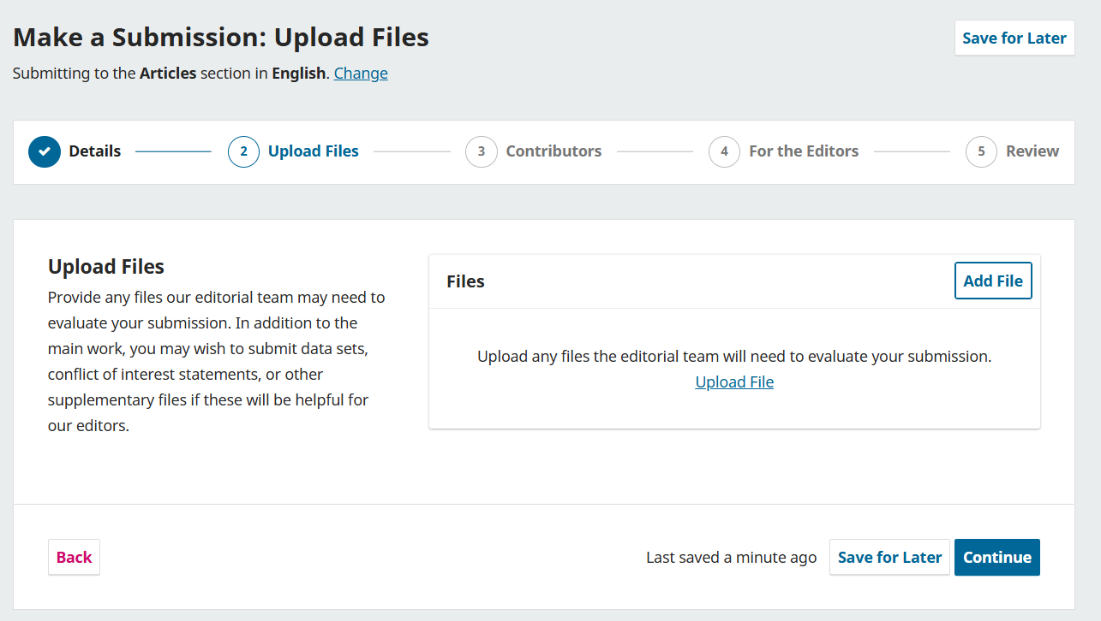
Upload the article file and — if necessary — other materials. Specify the file type and click «Continue»

Slide 7
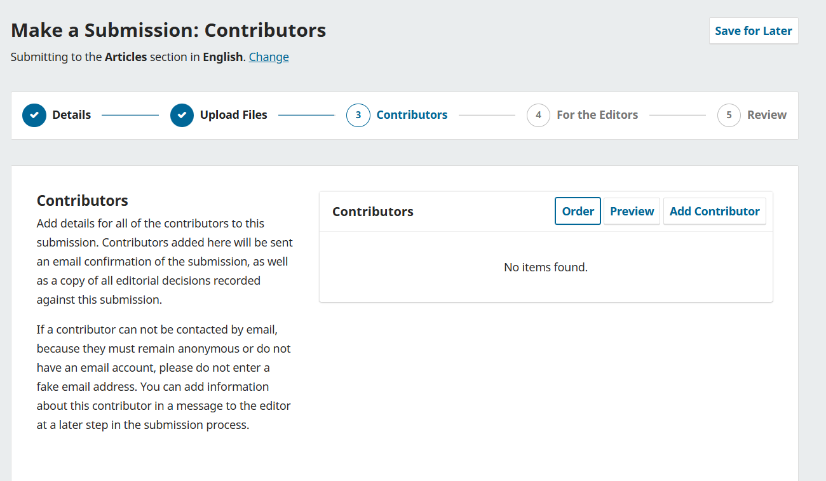
Fill in the details for all authors of the work and click the «Continue»

Slide 8
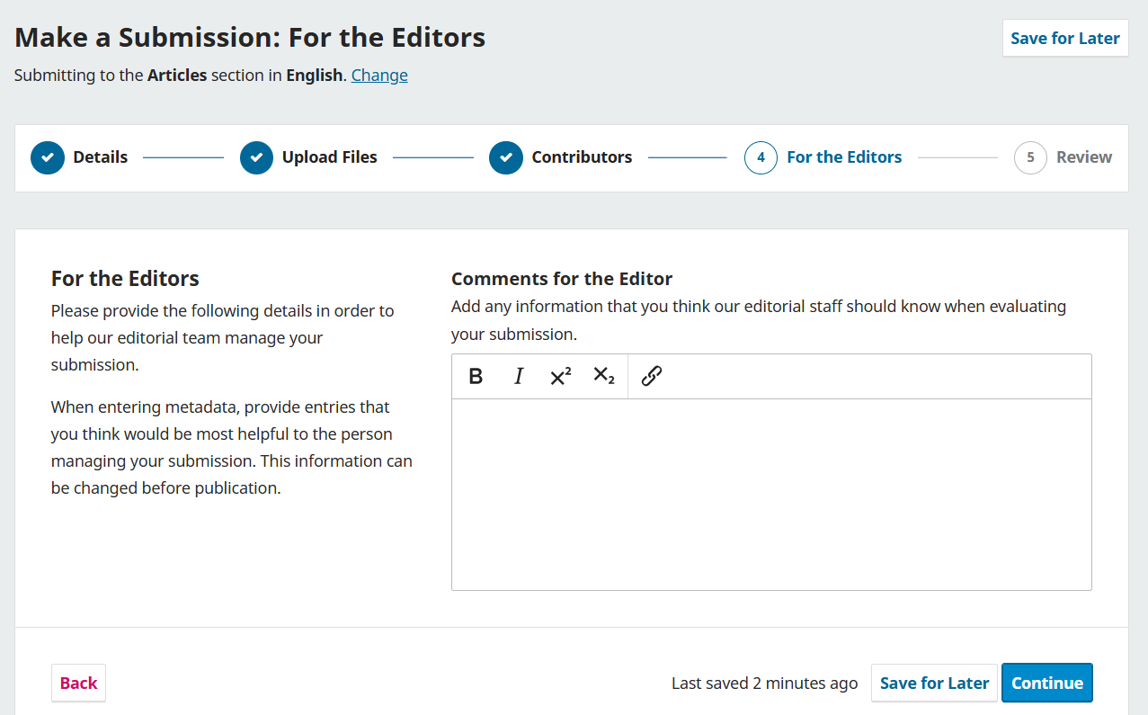
If you wish, you can leave a comment for the Editor with additional information about your work

Slide 9
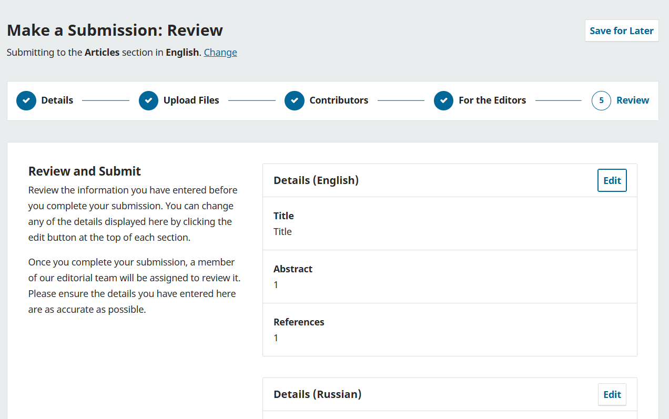
Check that the entered data is correct and, if everything is right, click «Submit» at the bottom of the page

Slide 10
Done!
Your article now appears in your submitted materials, and the Associate Editor will review it soon
The Editor reviews submissions within 3 business days. If you have not received a notification of the initial decision within this time, email us at psystudy.journal@gmail.com or psystudy@psystudy.ru

Slide 11
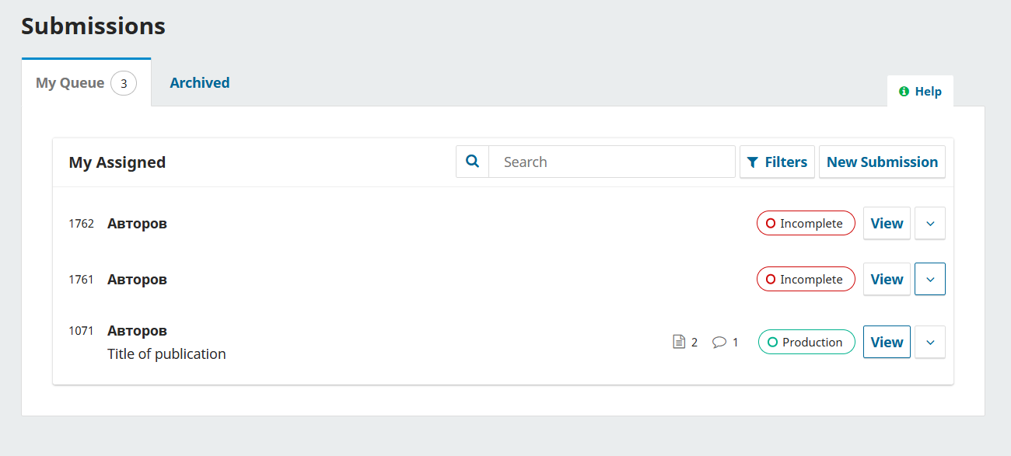
You can view information about the article by clicking «View». On the Submission tab, you can start a discussion with the Editor by clicking «Add discussion»

Slide 12
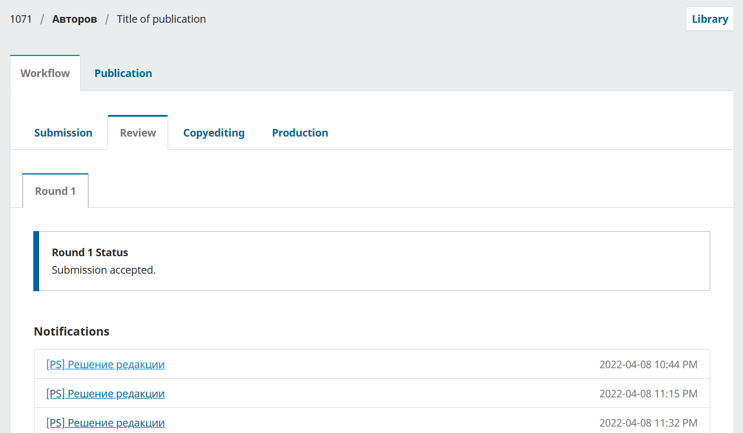
After the anonymous reviewer submits their review, you will see the editorial decision and the review file on the Review tab

Slide 13
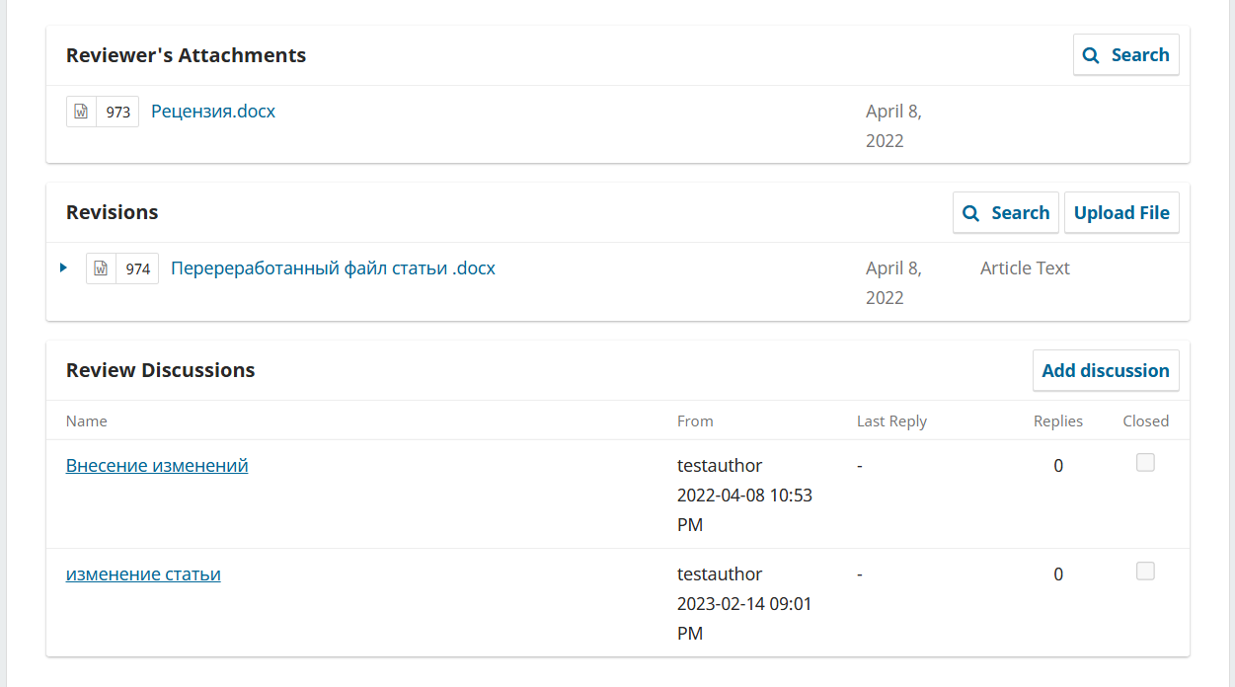
After making changes to the article file, upload the new version by clicking «Upload File» in the Revisions section. You can also start or continue a discussion with the Editor on the Review Discussions tab

Slide 14
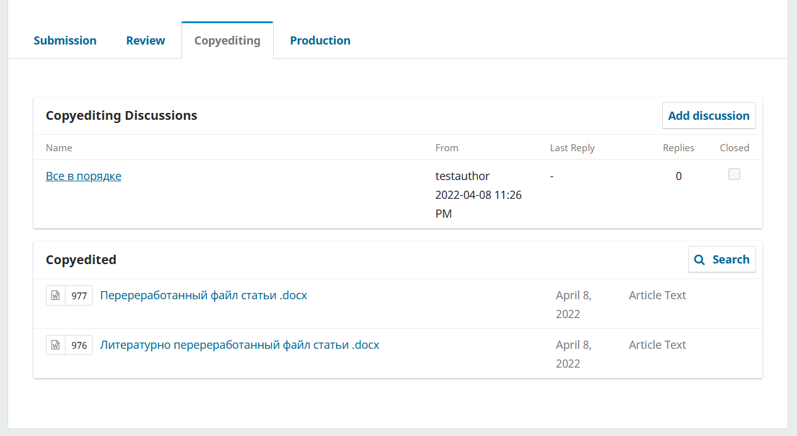
After the copyeditor sends their comments, you will see them as a file in the Copyedited section. You can start a discussion in the Copyediting Discussions section

Slide 15
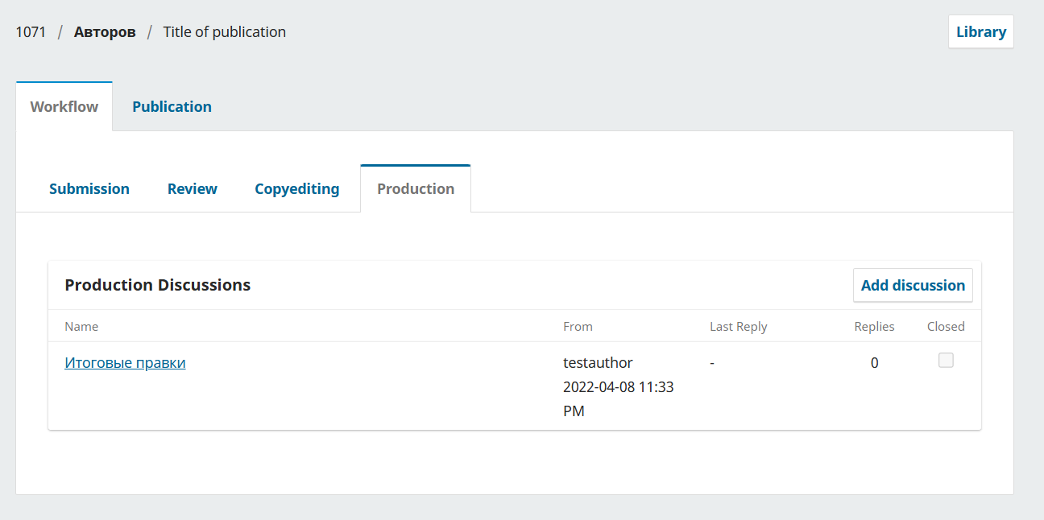
At the final stage, on the Production tab you can also start a discussion and, if needed, attach files

Slide 16
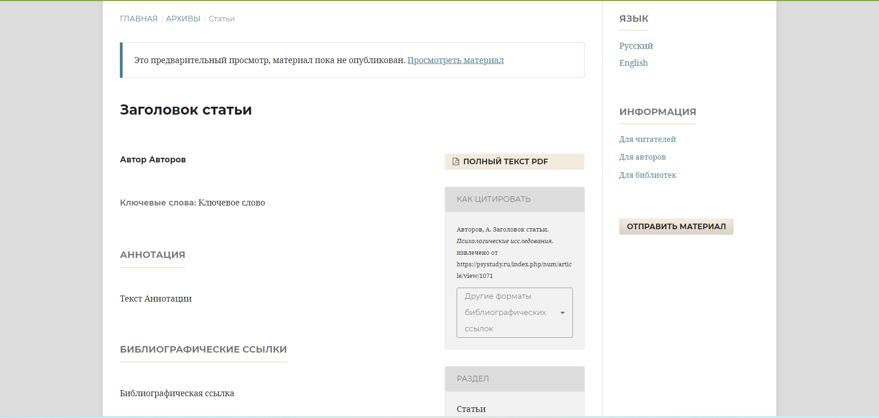
In the final step, the journal’s Editorial Team prepares the article proof in PDF format, assigns a DOI and adds the article to a journal issue

Slide 17
Thank you for your attention!
We look forward to your submissions

